Slide 1
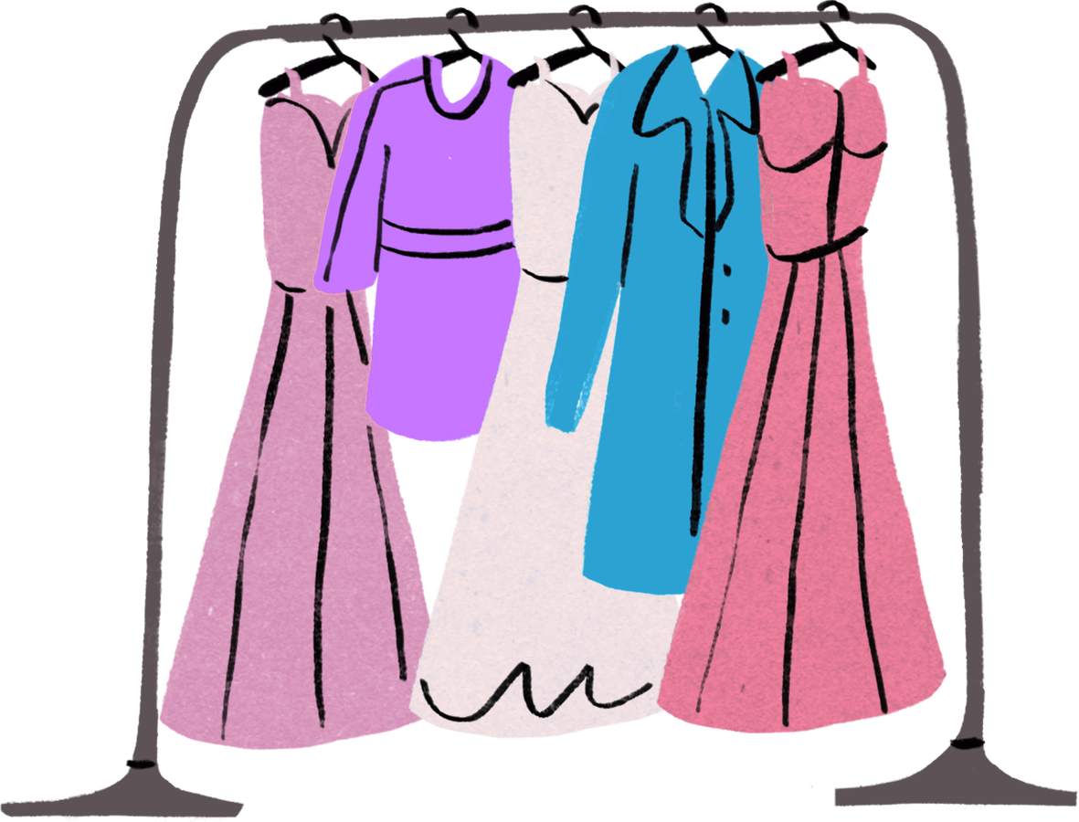
Retail Intelligence
A Data-Driven Study of Product Attributes & Sales Performance
Presented By: Smrithi P K

Slide 2
Index
Project Overview & Objectives
Dataset Information
Data Cleaning & Preprocessing
EDA & Visualizations
Key Insights & Findings
Conclusion

Slide 3
Project Overview & Objectives
This project analyzes how product attributes influence sales performance.
The goal is to uncover patterns between dress characteristics and customer purchasing behavior using Python-based data analysis.
Key Goals:
Understand sales trends
Analyze seasonal variations in sales performance
Identify high-performing product attributes
Discover patterns in customer preferences
Generate business insights for retailers

Slide 4
Dataset Information
Dataset : Dress Attributes & Sales Dataset
Source : UCI Machine Learning Repository - https://archive.ics.uci.edu/dataset/289/dresses+attribute+sales
Dataset Details:
There are 2 datasets - Attribute dataset & Dress Sales dataset
Attribute Dataset : 500 rows and 14 columns
Dress Sales Dataset : 500 rows and 24 columns
Attribute Columns: Style, Price, Season, Sleeve Length, Neckline, Pattern etc.
Sales Data: Daily sales for multiple days
Data Type: Mixed (Categorical + Numeric)
Purpose : To analyse how product attributes affect product sales performance.

Slide 5
Data cleaning & Preprocessing
Data Cleaning
Handling Missing Values: Attributes with large missing gaps were labeled as “Unknown” to avoid bias.
Mode Imputation: Applied to categorical columns with high data density to preserve the original distribution.
Duplicate Removal: Removed duplicate entries to maintain a unique record for each product.
Data Standardization
Uniform Labeling: Standardized categorical values to fix case sensitivity and naming variations.
Spell Checking: Corrected inconsistent labels across attributes.
Data Type Alignment: Converted columns to consistent formats for proper analysis.
Feature Engineering
New Feature Created: Total_Sales = Sum of daily sales columns for each Dress_ID
This metric helps evaluate overall product performance.
Data Integration
Dataset Merge: Combined Dress Attributes dataset with Sales dataset.
Join Method: Used Dress_ID as the primary key.
Result: Created a Master Dataset linking product features with sales performance.

Slide 6
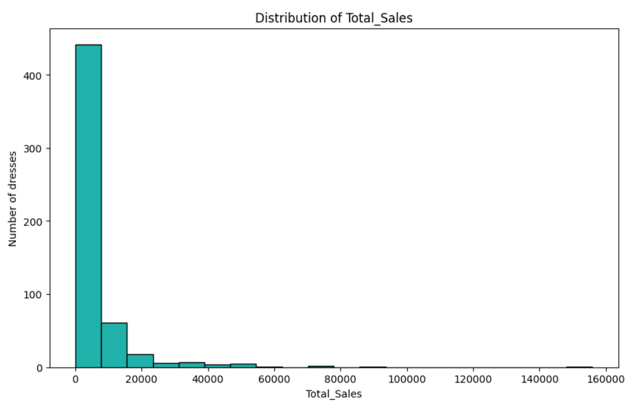
Total Sales Distribution
Insights :
The sales distribution is right-skewed, meaning most products have low to moderate sales.
A small number of products achieve very high sales, indicating top-performing items.
This pattern is common in e-commerce, where few products generate most of the revenue.

Slide 7
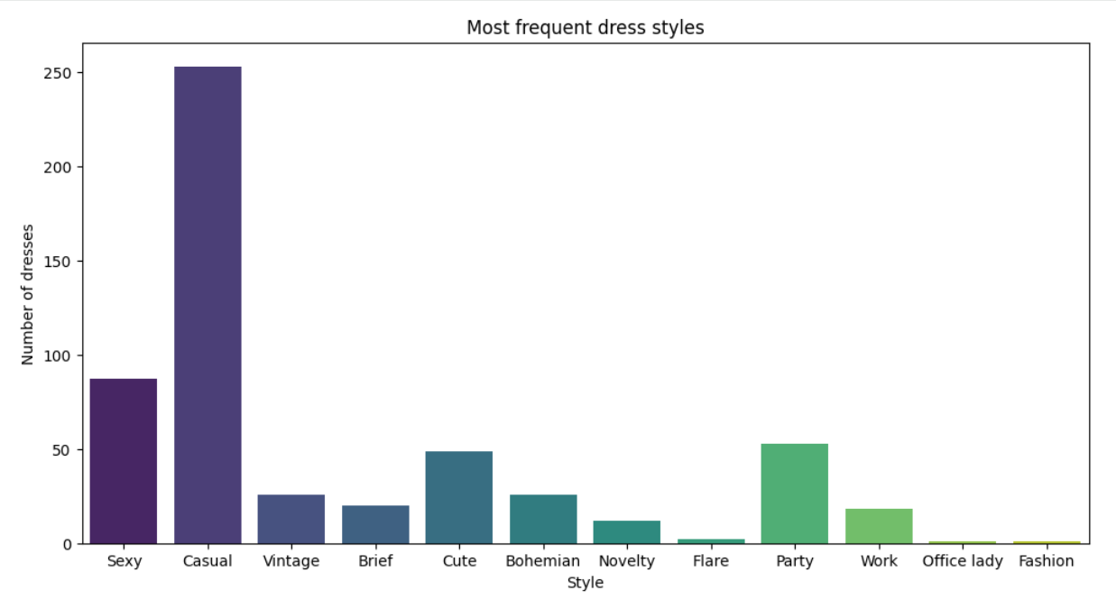
Most Frequent Dress Styles
Insights:
Casual and Sexy styles appear most frequently in the dataset.
Other styles such as Vintage and Novelty occur less often.
The product catalog mainly focuses on everyday fashion styles.

Slide 8
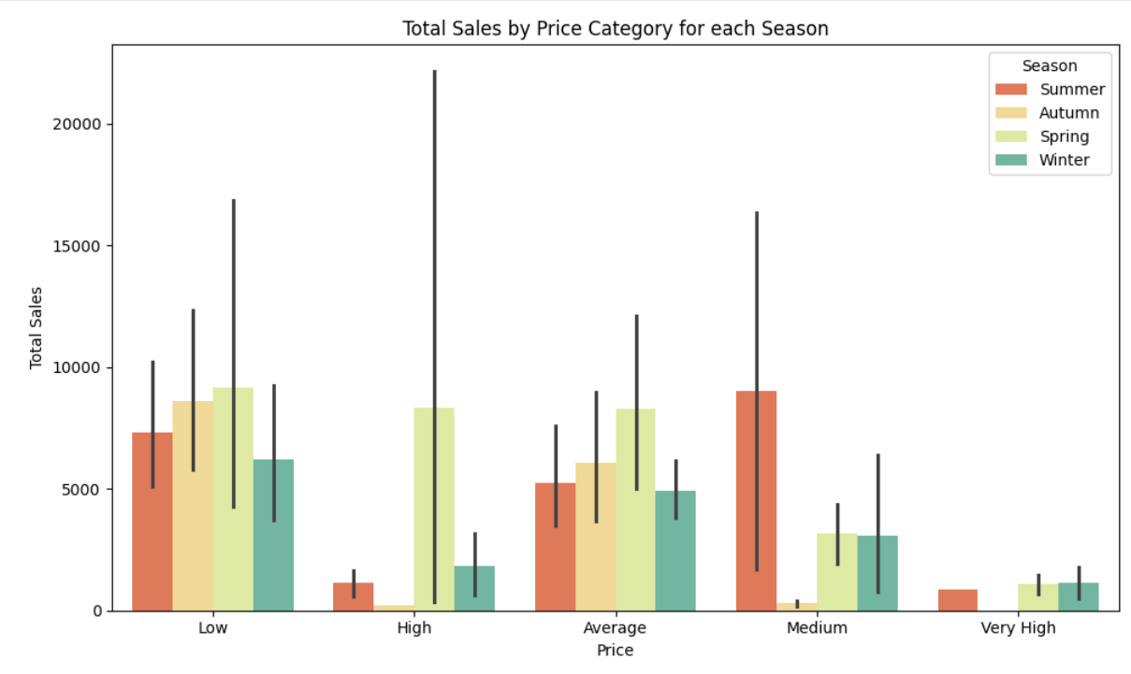
Product Distribution by Price Category
Insights:
This is a grouped bar chart and shows a combined impact of Price point and Seasonality on Total Sales.
There is a consistent performance of ‘Low’ Priced items.
Seasonal spikes for ‘Average’ and ‘High’ Priced items.
Price sensitivity may change seasonally, and there might be periods where customers are more willing to purchase higher-priced goods.

Slide 9
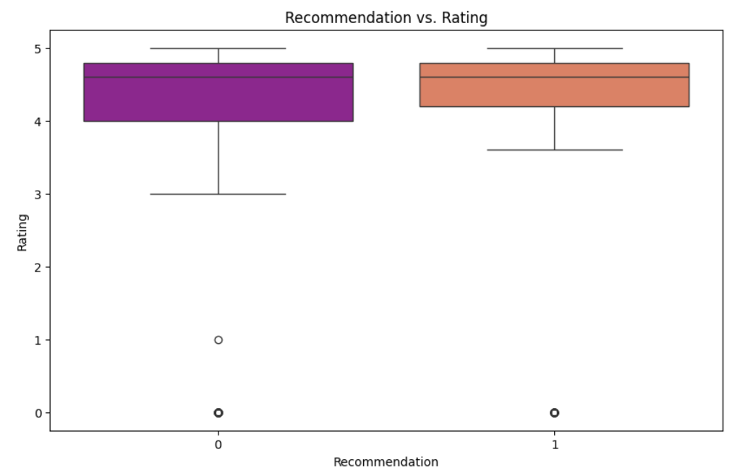
Customer Ratings by Recommendation Status
Insights:
Recommended products tend to have higher customer ratings.
Recommendation system acts as a Quality filter.
Non-recommended products show greater rating variability.
This suggests the recommendation system promotes higher-quality products.

Slide 10
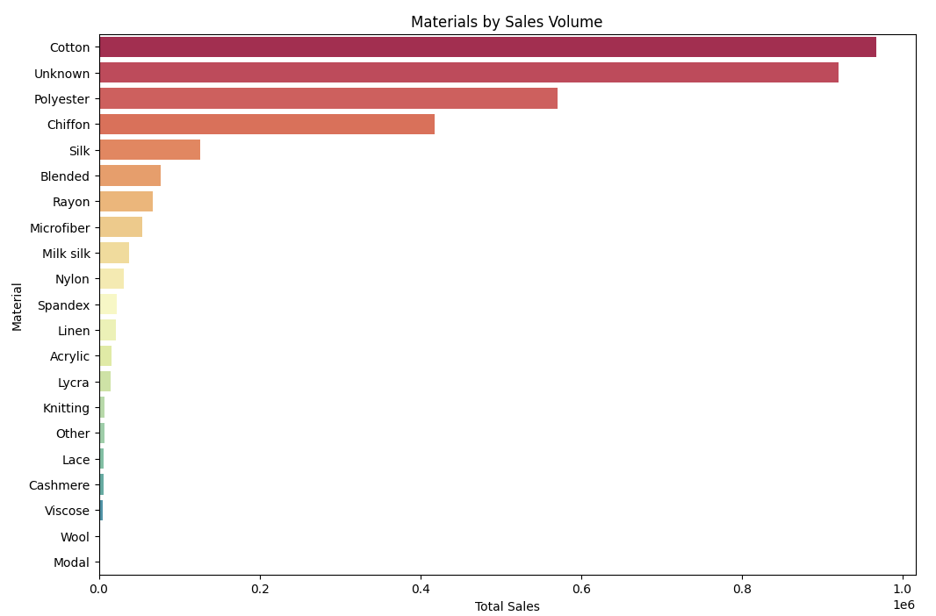
Sales Performance by Material Type
Insights:
Top selling materials like ‘Cotton’ and ‘Polyster’ are indicating high demand on these fabrics.
This suggests customers prefer comfortable and commonly used fabrics.
This highlights which materials should be prioritized in manufacturing and stocking.

Slide 11
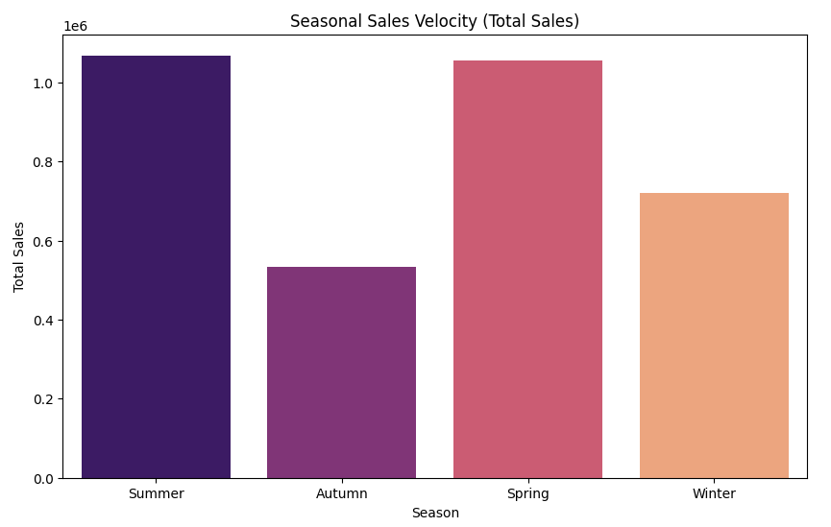
Seasonal Sales performance
Insights:
It shows a clear Seasonal Peaks and Troughs
'Summer' showing significantly higher total sales compared to other seasons. This identifies Summer as the peak sales period for the business.
'Autumn Sales Cliff’: There's a noticeable drop in sales volume from Summer to Autumn.
There is a Winter Bounce that sales pick up slightly in Winter, likely due to holiday shopping or end-of-year clearances.
Fashion sales are strongly influenced by seasonal trends.

Slide 12
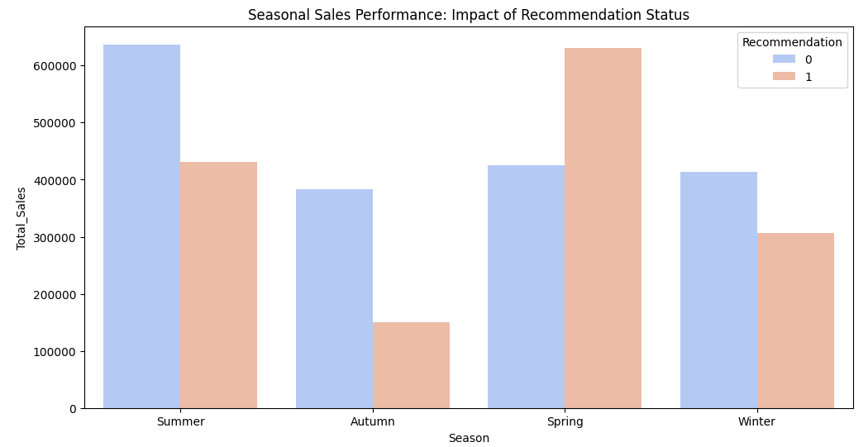
Season Sales: Impact of Recommendation
Insights:
Recommended products perform best during Spring, generating the highest seasonal sales.
The influence of recommendations varies across seasons, showing weaker impact in Summer, Autumn, and Winter.
Improving recommendation strategies during low-performing seasons could help increase overall sales.
Notes:
This chart compares total sales across seasons based on whether the product was recommended or not. We observe that recommended products perform exceptionally well during Spring, where sales are significantly higher than non-recommended items. However, in Summer, Autumn, and Winter, non-recommended products still generate higher sales. This suggests that the effectiveness of recommendation systems may vary across seasons. Retailers can therefore optimize their recommendation strategies during high-demand seasons like Spring to maximize sales

Slide 13
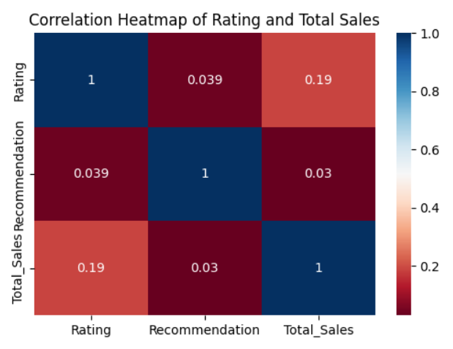
Correlation Analysis of Product Attributes
Insights:
Rating vs Total Sales - Suggests that while higher ratings might contribute to slightly higher sales
Recommendation vs Total Sales - The correlation is weaker
Recommendation vs Rating - Weak +ve correlation, items with higher ratings are only marginally more likely to be recommended.
Customer satisfaction and marketing influence product performance

Slide 14
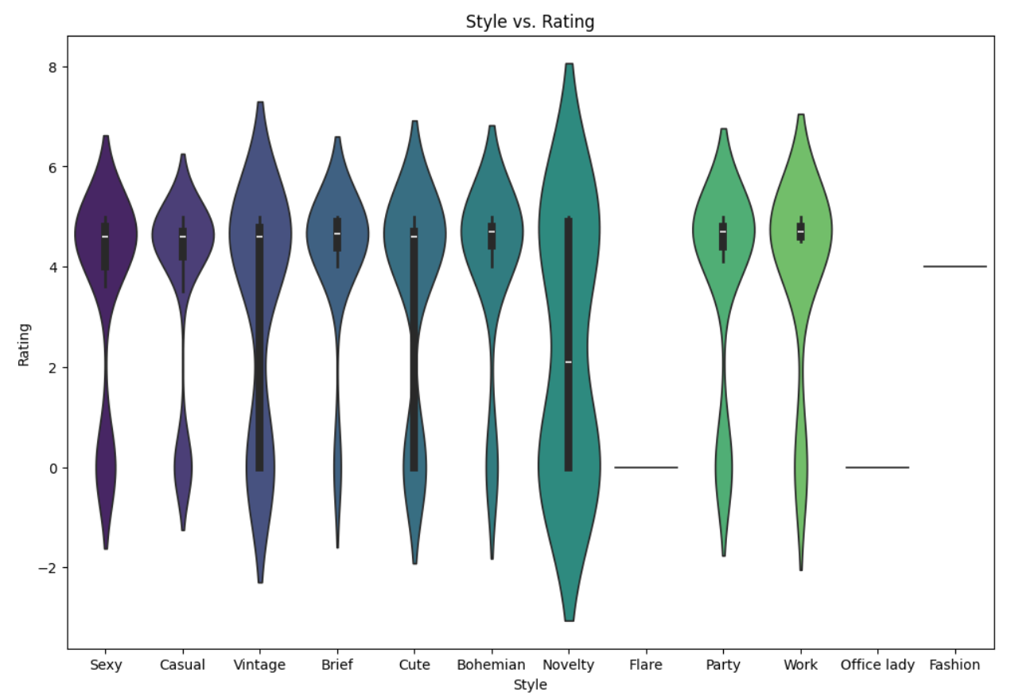
Style vs. Rating
Insights:
Certain styles like 'Casual’ and ‘Sexy’ have a very tight rating distribution, meaning they are reliable for customers.
‘Novelty’ styles have highly volatile ratings. This suggests higher Return Rate Risks for these categories.
Styles with wider "violins" show inconsistent quality, leading to unpredictable customer satisfaction.
High volatility suggests that the product doesn't fit every body type equally, leading to more returns.
Notes:
Casual and Sexy styles are stable. Because its having tight rating distribution.
For novelty and vintage styles have Volatile ratings. This suggests higher Return Rate Risks for these categories.

Slide 15
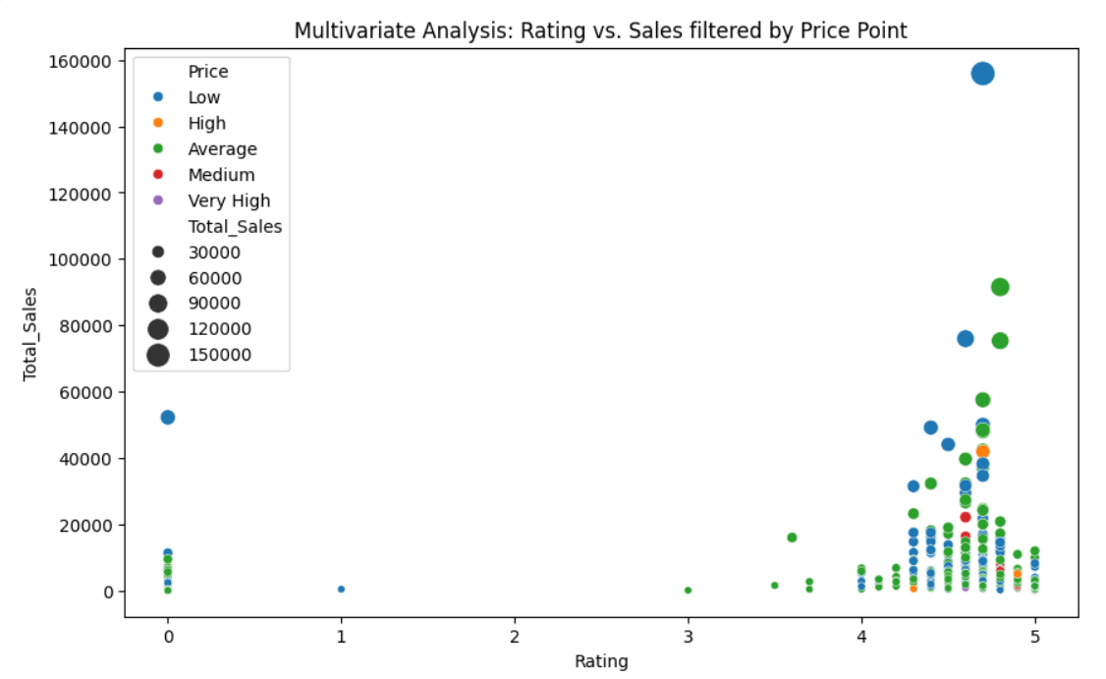
Relationship between Rating, Sales and Price
Insights:
Products with high ratings and moderate prices achieve the highest sales.
Extremely high-priced products show lower sales volume.
The optimal product strategy combines good quality with reasonable pricing.

Slide 16
Key Insights and Findings
The “Sweet Spot” Pricing Strategy
Highest sales are observed in average-priced products with ratings above 4.0 rather than only perfect 5-star products.
Impact of Recommendation Systems
Recommended products show significantly higher sales velocity compared to non-recommended products.
Neutralizing the "Autumn Sales Cliff"
A sharp decline in sales occurs during Autumn, mainly due to seasonal mismatch in product materials.
Importance of Product Materials
Cotton, Polyester, and Chiffon are the top revenue-generating materials, but their success depends on proper seasonal alignment.

Slide 17
Conclusion
We can point out a Retail Success Formula
High Sales = Right Price + Good Rating + Strong Recommendation + Seasonal Alignment
Average Pricing Strategy: Products priced in the mid-range attract the highest number of buyers.
Good Ratings Matter: Items with ratings above 4.0 tend to gain customer trust and sell better.
Recommendation Visibility: Recommended products achieve higher sales due to increased platform visibility.
Seasonal Product Alignment: Matching product materials and styles with seasonal demand improves sales performance.
Then, retailers can make better inventory decisions, improve product recommendations, and ultimately maximize profitability.

Slide 18
Thank you

